Slide 1
UML Activity Diagrams
In UML an activity diagram is used to display the sequence of actions
They show the workflow from start to finish
Detail the many decision paths that exist in the progression of events contained in the activity
Very useful when parallel processing may occur in the execution of some activities

Slide 2
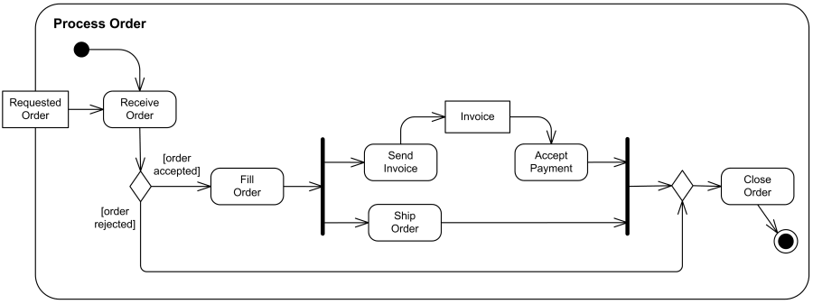
UML Activity Diagrams
An example of an activity diagram is shown below
(We will come back to that diagram)

Slide 3
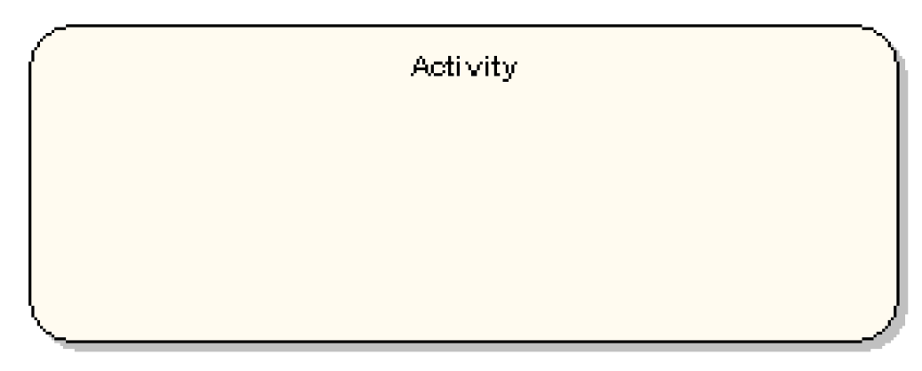
Activity
An activity is the specification of a parameterized sequence of behavior
Shown as a round-cornered rectangle enclosing all the actions and control flows

Slide 4
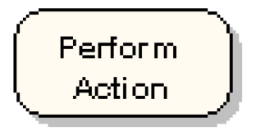
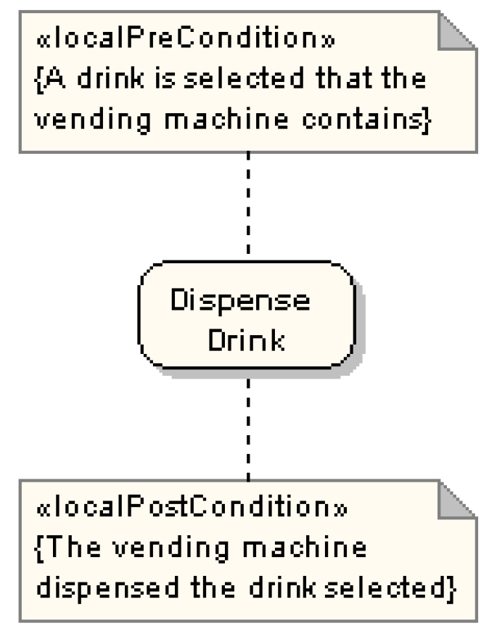
Actions and Constrains
An action represents a single step within an activity
Constraints can be attached to actions

Slide 5
Control Flow
Shows the flow of control from one action to the next
Its notation is a line with an arrowhead.
Initial Node
Final Node, two types:
Activity Final Node Flow Final Node

Slide 6
Objects Flow
An object flow is a path along which objects or data can pass
An object is shown as a rectangle
A short hand for the above notation

Slide 7
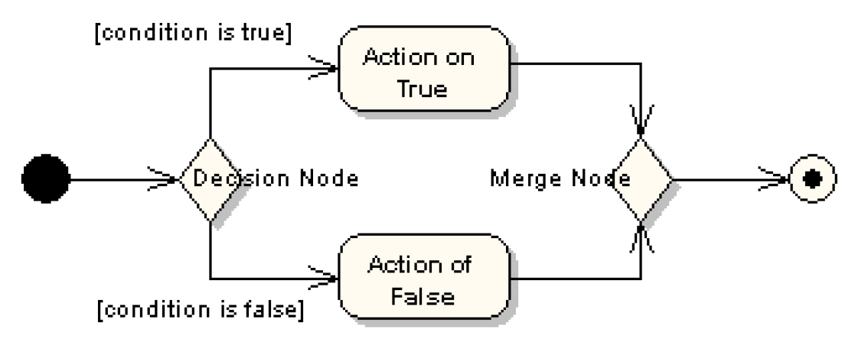
Decision and Merge Nodes
Decision nodes and merge nodes have the same notation: a diamond shape
The control flows coming away from a decision node will have guard conditions

Slide 8
Fork and Join Nodes
Forks and joins have the same notation: either a horizontal or vertical bar
They indicate the start and end of concurrent threads of control
Join synchronizes two inflows and produces a single outflow
The outflow from a join cannot execute until all inflows have been received

Slide 9
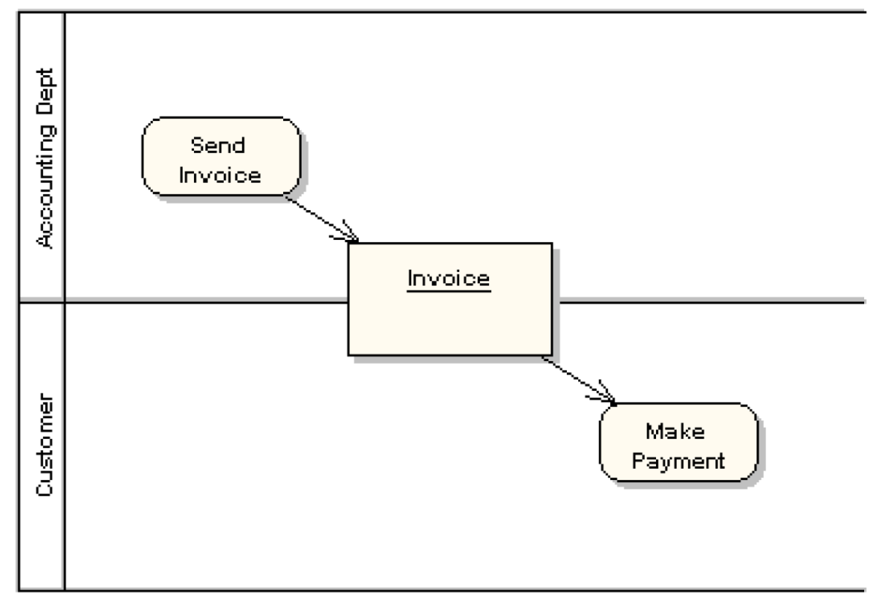
Partition
Shown as horizontal or vertical swim lane
Represents a group of actions that have some common characteristic

Slide 10
UML Activity Diagrams
Coming back to our initial example

Slide 11
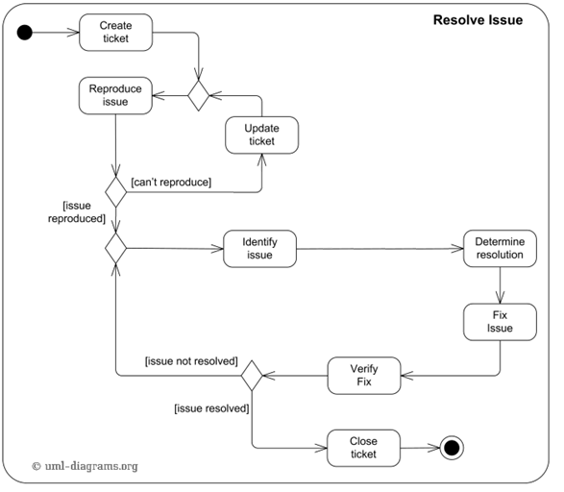
Issue Handling in Software Projects
Courtesy of uml-diagrams.org

Slide 12
More on Activity Diagrams
Interruptible Activity Regions
Expansion Regions
Exception Handlers

Slide 13
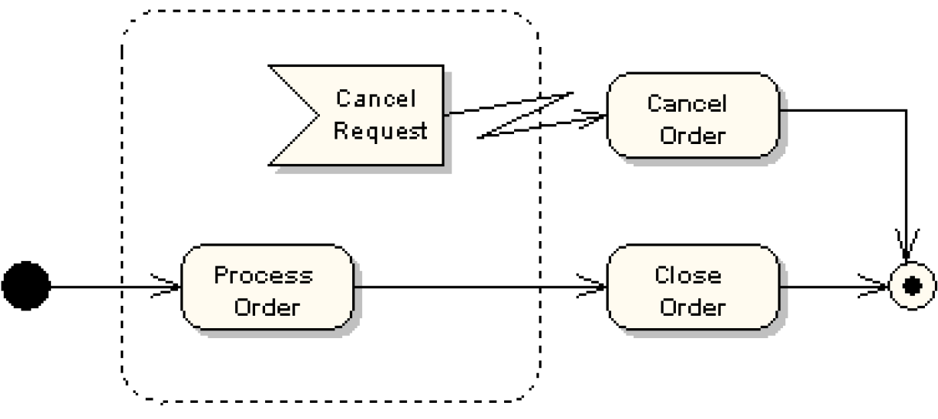
Interruptible Activity Region
Surrounds a group of actions that can be interrupted
Example below:
“Process Order” action will execute until completion, when it will pass control to the “Close Order” action, unless a “Cancel Request” interrupt is received, which will pass control to the “Cancel Order” action.

Slide 14
Expansion Region
An expansion region is an activity region that executes multiple times to consume all elements of an input collection
Example of books checkout at a library modeled using an expansion region:
Checkout Books
Find Books to Borrow
Checkout Book
Show Due Date
Place Books in Bags

Slide 15
Expansion Region
Another example: Encoding Video
Encode Video
Capture Video
Extract Audio from Frame
Encode Video Frame
Attach Audio to Frame
Save Encoded Video

Slide 16
Exception Handlers
An exception handler is an element that specifies what to execute in case the specified exception occurs during the execution of the protected node
In Java
“Try block” corresponds to “Protected Node”
“Catch block” corresponds to the “Handler Body Node”

